Slide 1

Ready! A.I.M.! Inject!
Bohdan Serednytskyi SoftServe
owasp-lviv.blogspot.com

Slide 2

Easy to exploit!
Severe impact!
Common in Web Apps!

Slide 3
SQL-Injection
The ability to inject SQL commands into the database engine through an existing application.

Slide 4
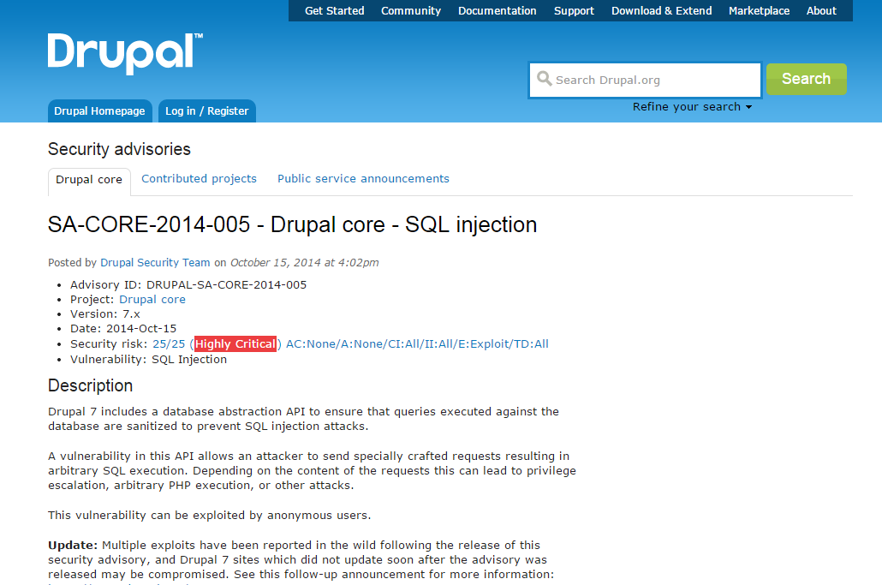
Real-life Examples

Slide 5
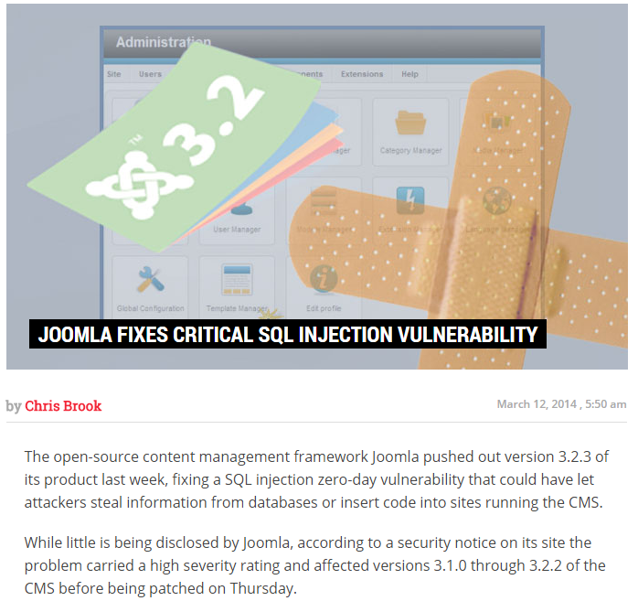
Real-life Examples

Slide 6
SQL-Injection Impact
Notes:
1. Heartland Payment Systems
Date: March 2008
Impact: 134 million credit cards exposed through SQL injection to install spyware on Heartland's data systems.
A federal grand jury indicted Albert Gonzalez and two unnamed Russian accomplices in 2009. Gonzalez, a Cuban-American, was alleged to have masterminded the international operation that stole the credit and debit cards. In March 2010 he was sentenced to 20 years in federal prison. The vulnerability to SQL injection was well understood and security analysts had warned retailers about it for several years. Yet, the continuing vulnerability of many Web-facing applications made SQL injection the most common form of attack against Web sites at the time.
Группа хакеров, называющая себя D33Ds Company, взломала голосовой сервис Yahoo Voice, похитила около 453 000 аккаунтов и разместила их в интернете. По сообщению экспертов в области безопасности Trusted Sec, логины и пароли были получены в результате атаки типа "Внедрение SQL-кода" (SQL Injection) на базу данных Yahoo. Сами хакеры говорят, что во время атаки на Yahoo Voice не преследовали коммерческую цель, а лишь хотели указать на уязвимые места серверов Yahoo. По словам взломщиков, в работе серверов компании имеется еще несколько "дыр", из-за которых Yahoo может понести гораздо более крупный урон, нежели чем 400 тысяч похищенных профилей Yahoo Voices. Платформа Yahoo Voices является продолжением проекта Associated Content, который Yahoo приобрела за 100 миллионов долларов в мае 2010 года. В декабре 2011 года разработки Associated Content вошли в сервисы Yahoo. В июне 2012 года в свободный доступ попали более чем 6,5 млн аккаунтов деловой социальной сети LinkedIn. Участники сервиса при попытке войти в свои аккаунты обнаружили, что их пароли больше не действительны, а в электронном почтовом ящике нашли сообщение от соцсети с инструкцией по изменению пароля.
Утечка паролей Linkedin обошлась компании в кругленькую сумму. Согласно опубликованной форме обязательной финансовой отчётности за II квартал 2012 года, фирма потратила от $500 тыс. до $1 млн на расследование инцидента.
Финансовый директор Linkedin Стив Сорделло (Steve Sordello) сказал, что в такую сумму обошлись работы по экспертизе и «другие элементы», имеющие отношение к взлому.
Миллион долларов на расследование инцидента — только начало. Финансовый директор пообещал потратить ещё два-три миллиона долларов в текущем квартале на «повышение безопасности инфраструктуры и данных». Можно предположить, что львиная доля пойдёт на оплату труда специалистов по безопасности, да и консультации лучших экспертов дорогого стоят.
Дополнительной статьёй расходов могут стать выплаты компенсаций по возможным искам со стороны пострадавших пользователей. Хотя это лишь гипотетическая возможность, но пример Yahoo показывает, что её нельзя полностью игнорировать. Если иск будет подан, то суд может признать, что компания предприняла недостаточные меры по обеспечению безопасности информации пользователей, и в этом случае ей придётся выплатить компенсацию. Здесь утечка гораздо более масштабная, чем у Yahoo: 6,5 миллиона паролей, по сравнению с 450 тыс. у Yahoo.
Хотя у Linkedin пароли «утекли» не в открытом виде, как у Yahoo, а в виде хэшей SHA-1, подобрать их довольно легко. Эксперты по безопасности упрекают Linkedin, что компания не использовала так называемую «соль», то есть случайное изменение хэша, чтобы затруднить восстановление оригинальных паролей, сравнивая значение с результатом, который выдаёт стандартная хэш-функция. Впоследствии представители Linkedin признали свой промах и сообщили, что начали «солить» хэш, да и вообще, давно собирались сделать это, просто не успели до взлома.

Slide 7

Data Leakage

Slide 8
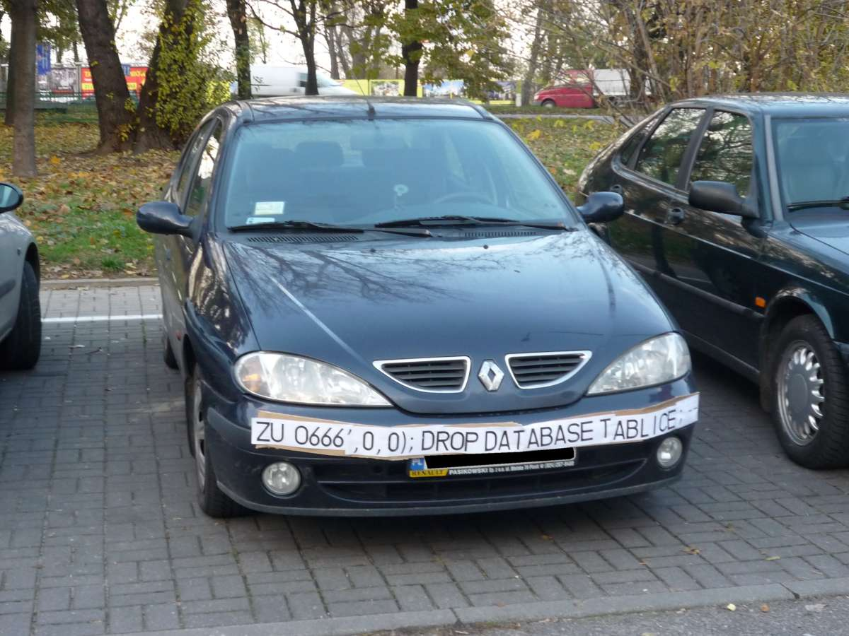
Data Modification

Slide 9

Denial of Access

Slide 10

Data Loss

Slide 11

Complete Host Takeover

Slide 12

SQL-Injection
Vulnerable request can handle Insert, Update, Delete
Almost all SQL databases and programming languages are potentially vulnerable
It is a flaw in "web application" development, it is not a DB or web server problem

Slide 13
SQL-Injection Anatomy
SQL-injection
SQL-injection
Blind SQL-injection
Blind SQL-injection
Double blind SQL-injection

Slide 14


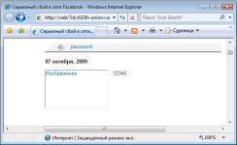
Scenario
http://example.com/app/accountView?id='%' or ‘0’=‘0’ union select null, version() #
Attacker
WEB-server
DB
SELECT first_name, last_name FROM users WHERE user_id = '%' or ‘0’=‘0’ union select null, version() #;

Slide 15
Example
private void queryDB(String u_name)
{
string sql = “select * from users where name = ‘ “ + u_name + “ ’ ”;
doQuery(sql);
}
1) select * from users where name = ‘Jerry’
2) select * from users where name = ‘Jerry’ or ‘1’ =‘1’

Slide 16

Let’s Do It!
Time for Demo

Slide 17
Example Blind SQL-injection
1) http://newspaper.com/items.php?id=2 and 1=2
SELECT title, description, body FROM items WHERE ID = 2 and 1=2
2) http://newspaper.com/items.php?id=2 and 1=1
Notes:
Blind SQL Injection
Use time delays or error signatures to determine extract information
Almost the same things can be done but Blind Injection is much slower and more difficult

Slide 18

Detection
Notes:
0x90.org: home of Absinthe, Mezcal, etc - http://0x90.org/releases.php SQLiX - http://www.owasp.org/index.php/Category:OWASP_SQLiX_Project sqlninja: a SQL Server injection and takover tool - http://sqlninja.sourceforge.net/ JustinClarke's SQL Brute - http://www.justinclarke.com/archives/2006/03/sqlbrute.html BobCat - http://www.northern-monkee.co.uk/projects/bobcat/bobcat.html sqlmap - http://sqlmap.sourceforge.net/ Scully: SQL Server DB Front-End and Brute-Forcer - http://www.sensepost.com/research/scully/ FG-Injector - http://www.flowgate.net/?lang=en&seccion=herramientas PRIAMOS - http://www.priamos-project.com/

Slide 19

Discovery of Vulnerabilities
Fields in web form
Script parameters in URL query strings
Values stored in cookies or hidden fields
Notes:
To find vulnerabilities all parameters in a web form must be checked. SQL Injection can happen in any of the following:
Fields in Web Forms
Script Parameters in Query Strings sent as part of the URL
Values stored in cookies that are sent back to the web application
Values sent in hidden fields

Slide 20

Fuzzing
Character sequence: ' " ) # || + >
SQL reserved words with white space delimiters
Delay query: ' waitfor delay '0:0:10'--
Notes:
Character sequence: ' " ) # || + >
SQL reserved words with white space delimiters
%09select (tab%09, carriage return%13, linefeed%10 and space%32 with and, or, update, insert, exec, etc)
Delay query ' waitfor delay '0:0:10'—
To find all the different entry points in a web application a web proxy or a fuzzer must be used.
With a fuzzer we insert different types of input into each entry point.
"Fuzzing" is an automated software testing technique that generates and submits random or sequential data to various entry points of an application in an attempt to uncover security vulnerabilities. We use this technique to send specific string combinations with SQL specific reserved characters and words.
We are looking for an application error or changes in the applications behavior or responses due to the insertion of one or several strings. For example, the delay query will make the application respond after 10 seconds if it is vulnerable and executing our command (in this case it would also have to be a MS SQL Server).

Slide 21

Tools
sqlmap: automatic SQL injection and database takeover tool
SQL Inject Me : Add-ons for Firefox
Zed Attack Proxy
Burp Suite
W3AF
Wapiti
Havij Pro
Nikto
IronWASP

Slide 22

Blow It Up!

Slide 23

Protection

Slide 24
Use of Prepared Statements (Parameterized Queries)

Slide 25
Unsecure Code
conn = pool.getConnection( );
String sql = "SELECT * FROM users WHERE userid='" + userid +"' AND password='" + password + "'";
stmt = conn.createStatement();
rs = stmt.executeQuery(sql);
Notes:
The use of prepared statements (aka parameterized queries) is how all developers should first be taught how to write database queries. They are simple to write, and easier to understand than dynamic queries. Parameterized queries force the developer to first define all the SQL code, and then pass in each parameter to the query later. This coding style allows the database to distinguish between code and data, regardless of what user input is supplied.
Prepared statements ensure that an attacker is not able to change the intent of a query, even if SQL commands are inserted by an attacker. In the safe example below, if an attacker were to enter the userID of tom' or '1'='1, the parameterized query would not be vulnerable and would instead look for a username which literally matched the entire string tom' or '1'='1.

Slide 26
Secure Code
PreparedStatement stmt = connection.prepareStatement("SELECT * FROM users WHERE userid=? AND password=?");
stmt.setString(1, userid);
stmt.setString(2, password);
ResultSet rs = stmt.executeQuery();
Notes:
The use of prepared statements (aka parameterized queries) is how all developers should first be taught how to write database queries. They are simple to write, and easier to understand than dynamic queries. Parameterized queries force the developer to first define all the SQL code, and then pass in each parameter to the query later. This coding style allows the database to distinguish between code and data, regardless of what user input is supplied.
Prepared statements ensure that an attacker is not able to change the intent of a query, even if SQL commands are inserted by an attacker. In the safe example below, if an attacker were to enter the userID of tom' or '1'='1, the parameterized query would not be vulnerable and would instead look for a username which literally matched the entire string tom' or '1'='1.

Slide 27
Is It Secure?
String query = "SELECT * FROM users WHERE userid ='"+ userid + "'" + " AND password='" + password + "'";
PreparedStatement stmt = connection.prepareStatement(query);
ResultSet rs = stmt.executeQuery();

Slide 28
Use of Stored Procedures

Slide 29
Secure Usage
String custname = request.getParameter("customerName");
try {
CallableStatement cs = connection.prepareCall("{call sp_getAccountBalance(?)}");
cs.setString(1, custname);
ResultSet results = cs.executeQuery();
// … result set handling
}
catch (SQLException se) {
// … logging and error handling
}
Notes:
Stored procedures have the same effect as the use of prepared statements when implemented safely. They require the developer to define the SQL code first, and then pass in the parameters after. The difference between prepared statements and stored procedures is that the SQL code for a stored procedure is defined and stored in the database itself, and then called from the application. Both of these techniques have the same effectiveness in preventing SQL injection so your organization should choose which approach makes the most sense for you.

Slide 30
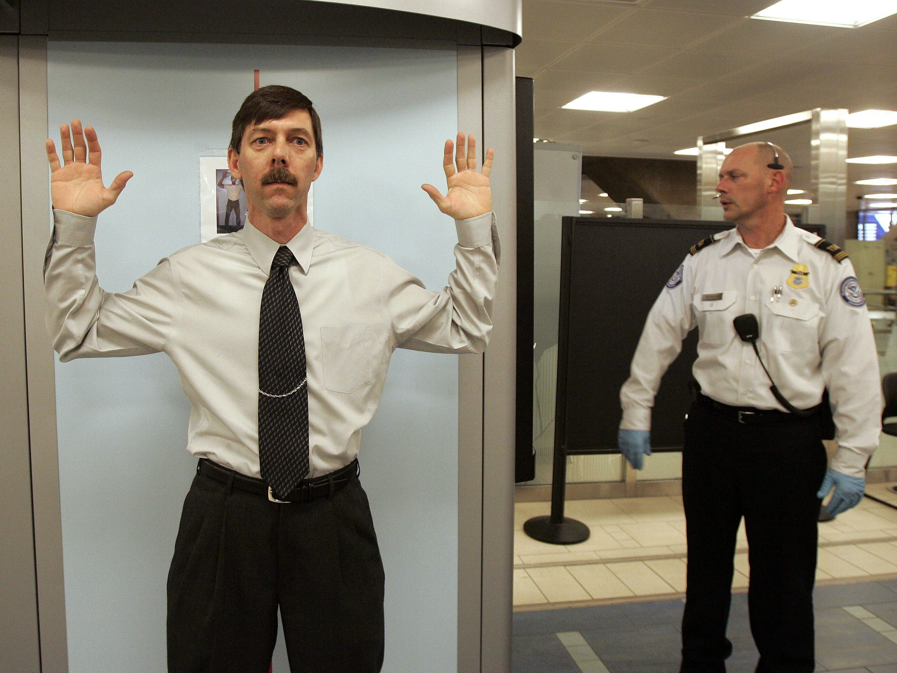
Escaping all User Supplied Input
OWASP Enterprise Security API
Notes:
ESAPI (The OWASP Enterprise Security API) is a free, open source, web application security control library that makes it easier for programmers to write lower-risk applications. The ESAPI libraries are designed to make it easier for programmers to retrofit security into existing applications. The ESAPI libraries also serve as a solid foundation for new development.
Allowing for language-specific differences, all OWASP ESAPI versions have the same basic design:
There is a set of security control interfaces. They define for example types of parameters that are passed to types of security controls.
There is a reference implementation for each security control. The logic is not organization‐specific and the logic is not application‐specific. An example: string‐based input validation.
There are optionally your own implementations for each security control. There may be application logic contained in these classes which may be developed by or for your organization. An example: enterprise authentication.
This project source code is licensed under the BSD license, which is very permissive and about as close to public domain as is possible. The project documentation is licensed under the Creative Commons license. You can use or modify ESAPI however you want, even include it in commercial products.
There are reference implementations for each of
the following security controls:
• Authentication
• Access control
• Input validation
• Output encoding/escaping
• Cryptography
• Error handling and logging
• Communication security
• HTTP security
• Security configuration

Slide 31

Web Application Firewall
A security solution on the web application level which does not depend on the application itself
Notes:
NAXSI is a WAF for NGINX.
The OWASP Stinger Project is not a full blown WAF, but it is a strong Java/J2EE input validation filter that can be put in front of your application. Developers consistently implement sporadic, ad-hoc input validation mechanisms for web applications. Lack of a centralized and well-defined input validation mechanism opens the application to a variety of attacks: including SQL Injection, Cross Site Scripting (XSS), and Command Injection. The OWASP Stinger Project aims to develop a centralized input validation component which can be easily applied to existing or developmental applications. Using a declarative security model, Stinger has the ability to validate all HTTP requests coming into an application. Stinger is such a simplistic yet strong validation engine that organizations have begun integrating it into their software development life-cycle.
Well Known Open Source Tools Of This Type
AQTronix - WebKnight
Trustwave SpiderLabs - ModSecurity
A recent new project by Qualys led by Ivan Ristic, the original ModSecurity author
Qualys - Ironbee
Commercial Tools from OWASP Members Of This Type
These vendors have decided to support OWASP by becoming members. OWASP appreciates the support from these organizations, but cannot endorse any commercial products or services.
art of defence - hyperguard
Trustwave - WebDefend Web Application Firewall
Deny All - rWeb
Fortify Software - Defender
Imperva - SecureSphere™
Penta Security - WAPPLES
Bayshore Networks - Application Protection Platform
Other Well Known Commercial Tools Of This Type
Applicure - DotDefender
Port80 Software - ServerDefender VP
Radware AppWall
Armorlogic - Profense
Barracuda Networks - Application Firewall
Bee-Ware - iSentry
BinarySec - Application Firewall
BugSec - WebSniper
Cisco - ACE Web Application Firewall
Citrix - Application Firewall
eEye Digital Security - SecureIIS
F5 - Application Security Manager
Forum Systems - Xwall, Sentry
mWEbscurity - webApp.secure
Ergon - Airlock
Privacyware - ThreatSentry IIS Web Application Firewall
Protegrity - Defiance TMS - Web Application Firewall
Xtradyne - Application Firewalls
Web Application Firewall (WAF) and Intrusion Detection (APIDS) rules and resources
APIDS on Wikipedia - http://en.wikipedia.org/wiki/APIDS PHP Intrusion Detection System (PHP-IDS) - http://php-ids.org/ http://code.google.com/p/phpids/ dotnetids - http://code.google.com/p/dotnetids/ Secure Science InterScout - http://www.securescience.com/home/newsandevents/news/interscout1.0.html Remo: whitelist rule editor for mod_security - http://remo.netnea.com/ GotRoot: ModSecuirty rules - http://www.gotroot.com/tiki-index.php?page=mod_security+rules The Web Security Gateway (WSGW) - http://wsgw.sourceforge.net/ mod_security rules generator - http://noeljackson.com/tools/modsecurity/ Mod_Anti_Tamper - http://www.wisec.it/projects.php?id=3 [TGZ] Automatic Rules Generation for Mod_Security - http://www.wisec.it/rdr.php?fn=/Projects/Rule-o-matic.tgz AQTRONIX WebKnight - http://www.aqtronix.com/?PageID=99 Akismet: blog spam defense - http://akismet.com/ Samoa: Formal tools for securing web services - http://research.microsoft.com/projects/samoa/

Slide 32

Additional Defenses
IDS, IPS
Least Privileges
White List Input Validation
Notes:
Відключення повідомлень про помилки

Slide 33


